Slide 1
ADDERS

Slide 2
Circuits for Binary Addition
Half Adder
Half-adder Schematic

Slide 3
Full Adder
S = CI xor A xor B
CO = B CI + A CI + A B = CI (A + B) + A B

Slide 4
Full Adder Circuit
Standard Approach: 6 Gates
A
A
B
B
CI
CO
S
CI
A
B
Alternative Implementation: 5 Gates
A
A + B
A + B + CI
S
Half
S
Half
S
Adder
A B
Adder
CI (A + B)
B
CO
CO
CI
+
CO
A B + CI (A xor B) = A B + B CI + A CI

Slide 5
Cascaded 4 BIT
Parallel Adders / Ripple Adder
Parallel adders are digital circuits that compute the addition of variable binary strings of equivalent or different size in parallel. The schematic diagram of a parallel adder is shown, to add two 4 bit binary numbers. The circuit is laid out from right to left, similar to the way we add binary numbers. Therefore, the least significant column is on the right, and the most significant column is on the left. The boxes labeled FA/+ are full adders. The Carry out from each full adder is the Carry-in to the next higher full adder.

Slide 6
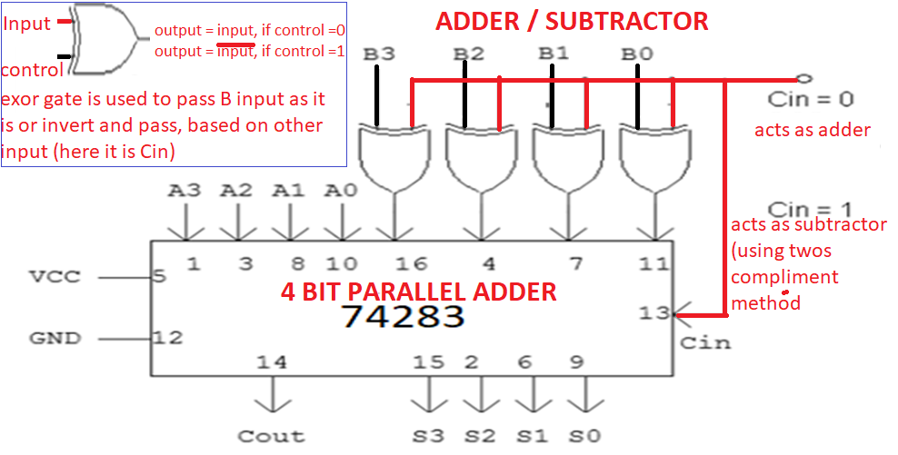
4 BIT Adder / Subtractor
The numbers being processed are A4 A3 A2 A1and B4 B3 B2 B1, while the answer is S4 S3 S2 S1. 4 bit adder is built as described in the previous slide, using 4 numbers of single bit full adders. Here ExOR gate is used, control the circuit to work as an 4 bit adder or 4 bit subtractor.

Slide 7
4 BIT Adder / Subtractor Examples:
Perform addition of following numbers, given in binary form
1000
1100
-------
10100
Perform addition of following numbers, given in decimal number system.
15 - 1111
+9 - 1001
---- -----------
1 1000
Perform addition of following numbers given in hexadecimal number system
A 1010
1001
-- ---------
1 3 1 0011
Note: for subtraction, take the 2s compliment of second number and add to the first number. Note, the carry will be the opposite of the actual value

Slide 8
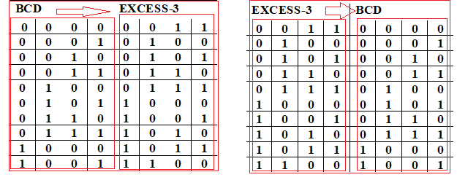
Application of Adder: used for Excess-3 to BCD Converter, vice versa
Binary Coded Decimal: Binary Coded Decimal is a method of using binary digits to represent the decimal digits 0 through 9. It is possible to assign weights to the binary bits according to their positions. The weights in the BCD code are 8, 4, 2 and 1. Ex: (137)₁₀ - BCD equivalent (0001 0011 0111)_{2.}
Excess-3 Code: This is an un-weighted code. Its code assignment is obtained from the corresponding value of BCD after the addition of (0011)₂.
BCD to Excess-3 (or) Excess-3 to BCD: Since each code uses four bits to represent a decimal digit, there must be four inputs and four output variables. The input variable are designated as B3, B2, B1, B0 and the output variables are designated as E3 , E2, E1, E0 in the truth table.

Slide 9
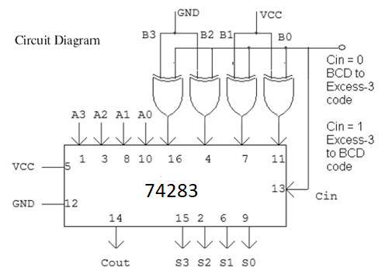
Application of Adder: used for Excess-3 to BCD Converter, vice versa
During the BCD to Excess 3 conversion: 0011 is applied to B3 B2 B1 B0 INPUTS of 4 bit adder (GND-0,VCC-1).
During Excess 3 to BCD conversion, 3 (0011) is subtracted from the number, using twos compliment method.

Slide 10
Delay Analysis of Ripple Adder
Carry out of a single stage can be implemented in 2 gate delays
For a 16 bit adder, the 16th bit carry is generated after 16 * 2 = 32 gate delays.
The sum bit takes one additional gate delay to generate the sum of the 16th bit after 15th bit carry
15 * 2 + 1 = 31 gate delays
Takes too long - need to investigate FASTER adders!

Slide 11
Critical delay: the propagation of carry from low to high order stages
late
arriving
signal
@0
A
@1
@N+1
@0
B
@N
CI
CO
@0
A
@N+2
two gate delays
to compute CO
@0
B
@1
C
0
A
0
S
@2
0
0
B
0
C
@2
4 stage
adder
1
A
1
S
@3
1
1
B
C
@4
1
2
A
2
S
@5
2
2
B
C
@6
2
3
A
3
S
3
@7
B
3
C
@8
final sum and
carry
3
4

Slide 12
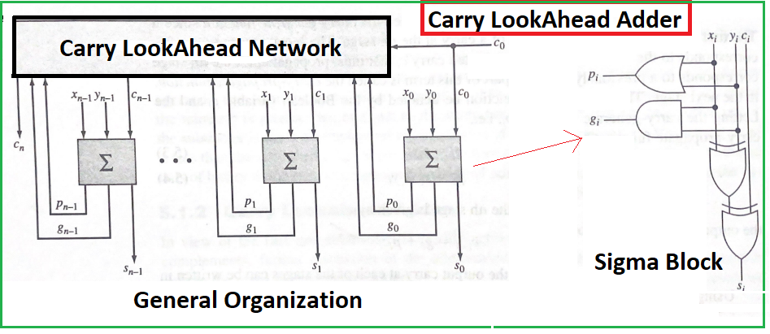
ADDERS
Carry input at each stage to each stage is direct function of operand bits.
Thus the idea of having SUM and CARRY outputs of the ith stage be a function of xi,yi and ci is replaced by having these outputs be a function of x0,x1,…,xi, y0,y1,…,yi and c0

Slide 13
Let us write S and Cout expressions for full adder, in terms of inputs X and Y and Cin, for ‘i’ th bit
Si = Xi .xor. Yi .xor. Ci
Ci+1 = Xi Yi + Xi Ci + Yi Ci
= Xi Yi + Ci (Xi + Yi)
= Xi Yi + Ci (Xi .or. Yi)
Let us represent, XiYi by Gi (also called as Carry generate function) &
Xi.or.Yi by Pi (also called carry propagate function)
= Gi + Ci Pi
Now, lets write the these expressions, for C1,C2,C3 and C4
C1 = G0 + P0 C0
C2 = G1 + P1 C1 = G1 + P1 G0 + P1 P0 C0
C3 = G2 + P2 C2 = G2 + P2 G1 + P2 P1 G0 + P2 P1 P0 C0
C4 = G3 + P3 C3 = G3 + P3 G2 + P3 P2 G1 + P3 P2 P1 G0 + P3 P2 P1 P0 C0
Important: Carry input at each stage is direct function of operand bits. Thus the idea of having SUM and CARRY outputs of the ith stage be a function of xi,yi and ci is replaced by having these outputs be a function of x0,x1,…,xi, y0,y1,…,yi and c0

Slide 14
C1 = G0 + P0 C0
C2 = G1 + P1 C1 = G1 + P1 G0 + P1 P0 C0
C3 = G2 + P2 C2 = G2 + P2 G1 + P2 P1 G0 + P2 P1 P0 C0
C4 = G3 + P3 C3 = G3 + P3 G2 + P3 P2 G1 + P3 P2 P1 G0 + P3 P2 P1 P0 C0
C0
C0
C0
P0
C1
P0
P0
G0
P1
P1
P2
P2
G0
P3
C0
P1
G0
P0
P2
P1
P1
P2
G1
C3
P3
G0
C2
P2
G1
P1
P2
G2
P3
G1
G2
C4
P3
G3

Slide 15
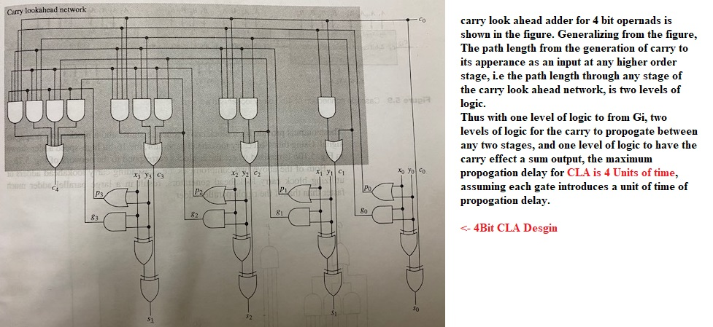
Carry Look Ahead Adder

Slide 16
Even though CLA performs high speed addition based on the carry look ahead principle, it presents a limitation in the realization of large high speed adders. The carry lookahead network can get quite large in terms of gates and gate inputs as the number of bits in the operands increases.
One approach to circumvent this problem is to divide the bits of the operands into blocks. Then, by using carry look ahead adders/carry look ahead generators for each block, their cascade connection results in a large high speed adders.
Cascading CLA adders
Using block CLA generators

Slide 17
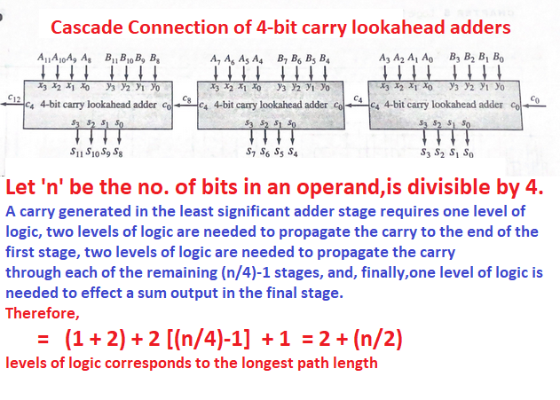
Note: in this case ripple carries occur between the cascaded 4 bit carry look ahead adders

Slide 18
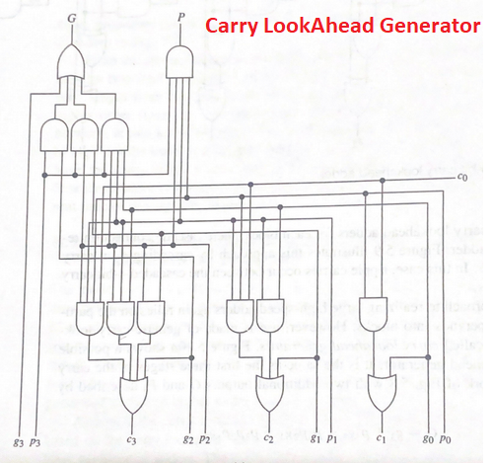
It is the same as the first three stages of the carry look ahead network (of CLA adder), with two additional G and P, known as “block carry generate signal” and “block carry propagate signal”
G = g3 + p3g2 + p3p2g1 + p3p2p1g0
P = p3p2p1p0
**Extra info: Not in syllabus**

Slide 19
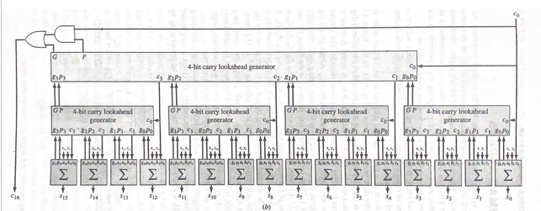
Using these 4 bit carry lookahead generator, the 16 bit high speed
adders are realized (Extra info: not in syllabus)

Slide 20
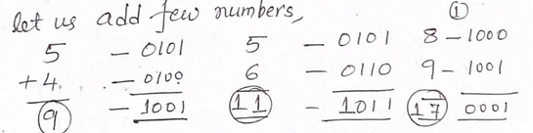
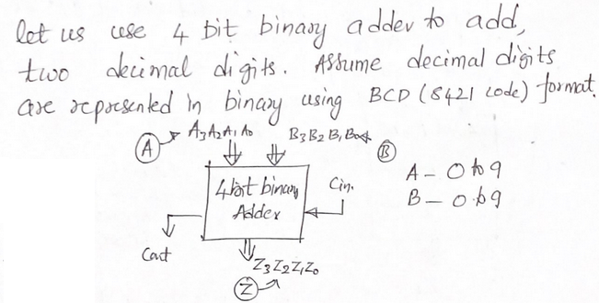
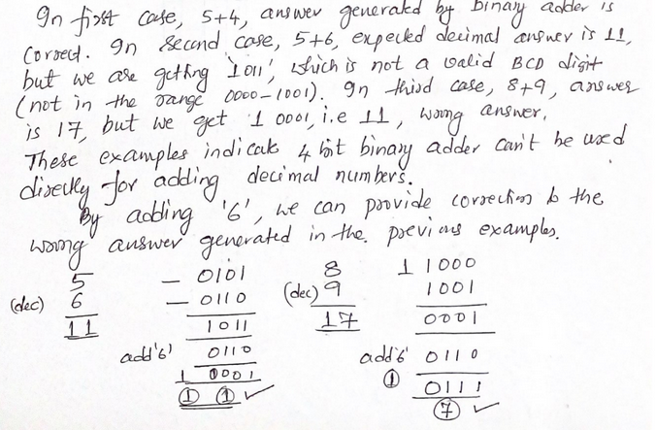
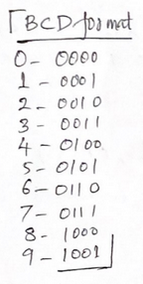
Decimal Adder

Slide 21
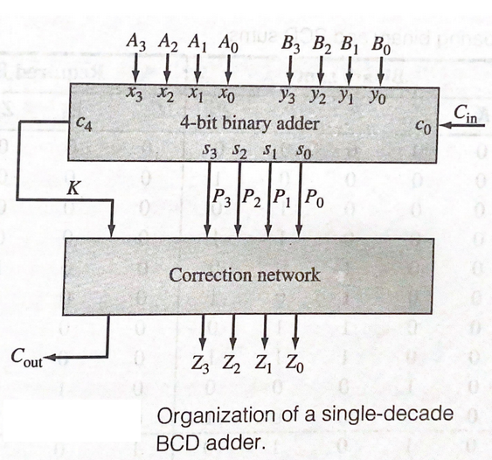
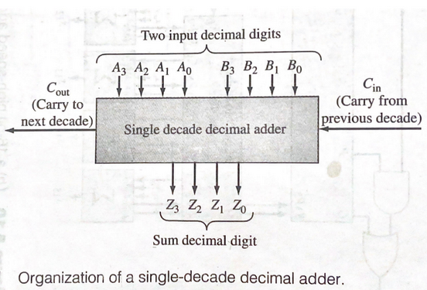
Decimal Adder

Slide 22
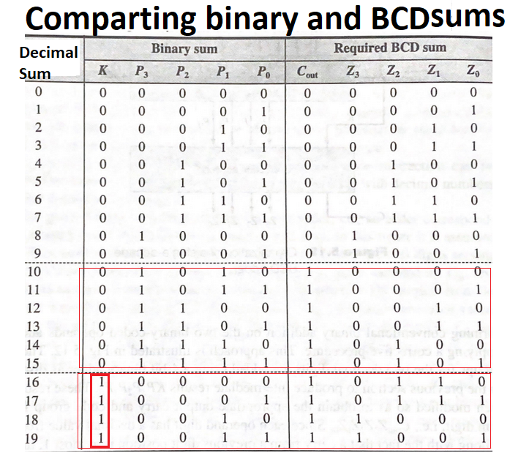
If the sum of the two decimal digits and input carry is less than 10, the required BCD sum is same as Binary Sum, produced by the 4 bit binary adder,
K P3P2P1P0 = Cout Z3Z2Z1Z0
The correction, of adding ‘6’ is required in two cases.
Answer is invalid BCD codes, (A to F), decimal sums of 10 throguh 15
K P3P2P1P0 –>0 1010, 0 1011, 0 1100,
0 1101, 0 1110, 0 1111
Answer produces, the Carry, decimal sums 16 through 19
K P3P2P1P0 -> 1 0000, 1 0001, 1 0010,
1 0011

Slide 23
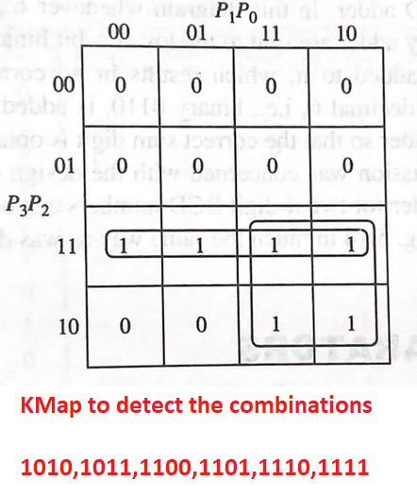
from the Kmap
ADD_6 = P3P2 + P3P1
Including the Carry output (K), in the expression, the Boolean expression for adding the correction is
ADD_6 = K + P3P2 + P3P1

Slide 24
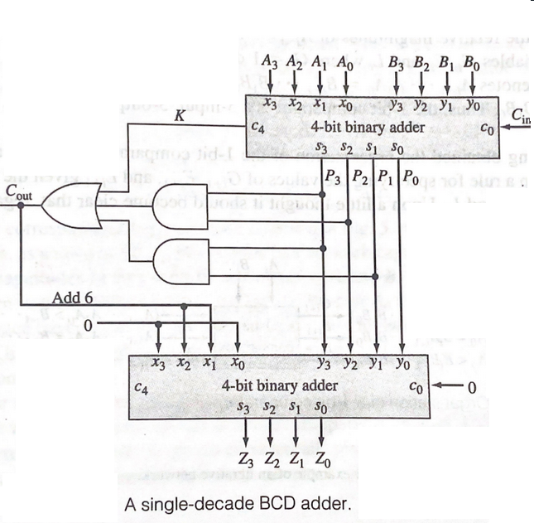
Corrective network is realised using another 4 bit binary adder, whenever ADD_6 is true, 0110 (6) is applied as one of the inputs to second adder, to add 6 to the result produced by the first adder.
Final Cout of the BCD adder is same as ADD_6 output.
In this diagram, Whenever Cout (i.e ADD_6) Is 0, the output of the first adder is added with 0. Whenver Cout (ADD_6) is 1, the output of first adder is added with 6 (0110).

Slide 25
Comparators
Compare the magnitude of two binary numbers for the purpose of establishing whether one is greater than, equal to, or less than the other.
A comparator makes use of a cascade connection of identical subnetworks similar to the case of the parallel adder.

Slide 26
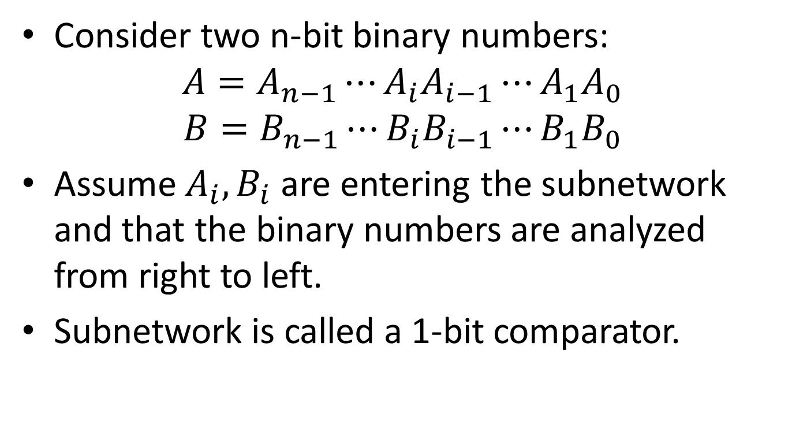
Comparators
Consider two n-bit binary numbers:
$$A=A_{n−1}⋯A_{i}A_{i−1}⋯A_{1}A_{0}$$
$$B=B_{n−1}⋯B_{i}B_{i−1}⋯B_{1}B_{0}$$
Assume $A_{i}, B_{i}$ are entering the subnetwork and that the binary numbers are analyzed from right to left.
Subnetwork is called a 1-bit comparator.

Slide 27
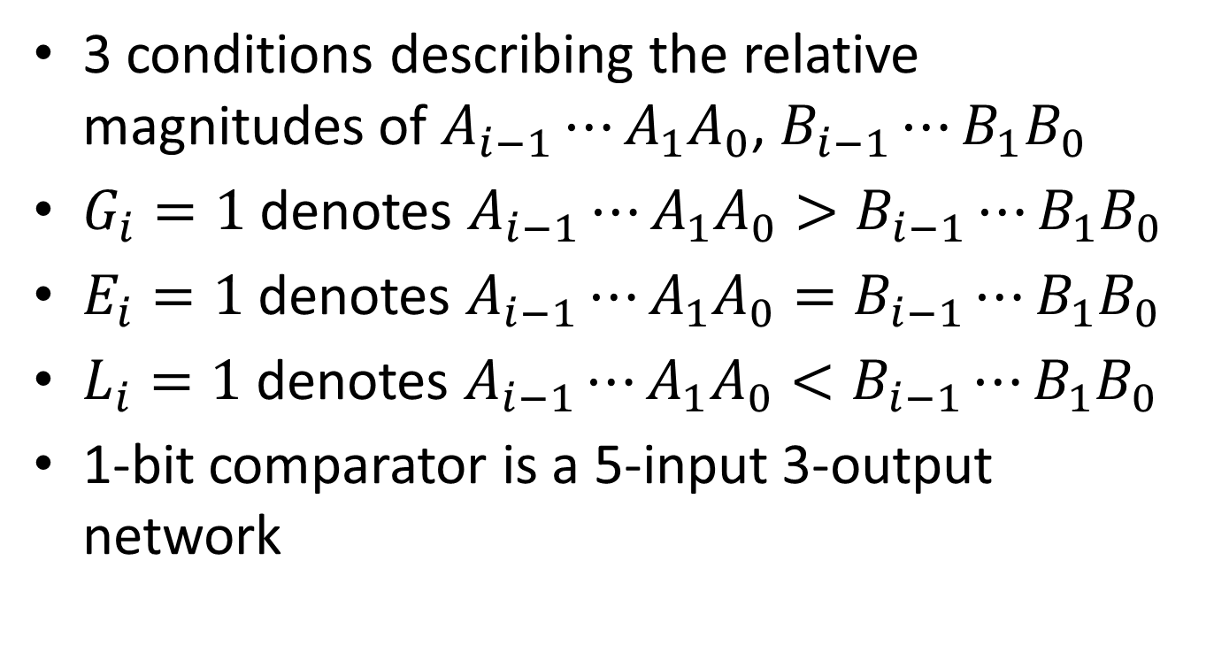
Comparators
3 conditions describing the relative magnitudes of $A_{i−1}⋯A_{1}A_{0}$, $B_{i−1}⋯B_{1}B_{0}$
$G_{i}=1$ denotes $A_{i−1}⋯A_{1}A_{0}>B_{i−1}⋯B_{1}B_{0}$
$E_{i}=1$ denotes $A_{i−1}⋯A_{1}A_{0}=B_{i−1}⋯B_{1}B_{0}$
$L_{i}=1$ denotes $A_{i−1}⋯A_{1}A_{0}<B_{i−1}⋯B_{1}B_{0}$
1-bit comparator is a 5-input 3-output network

Slide 28
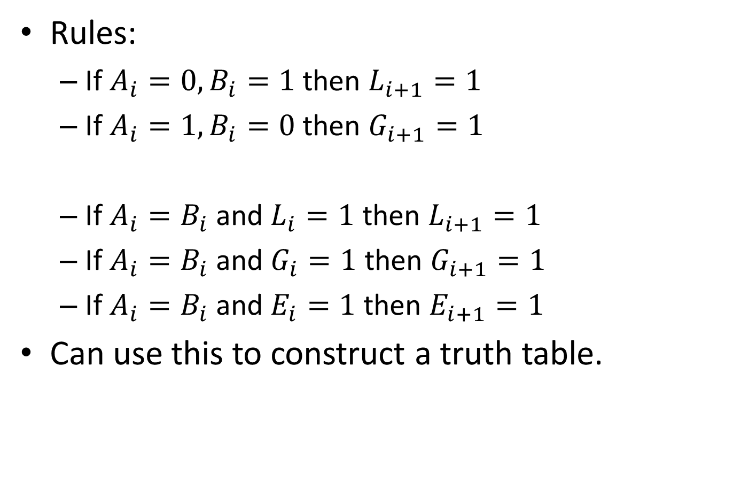
Comparators
Rules:
If $A_{i}=0, B_{i}=1$ then $L_{i+1}=1$
If $A_{i}=1, B_{i}=0$ then $G_{i+1}=1$
If $A_{i}=B_{i}$ and $L_{i}=1$ then $L_{i+1}=1$
If $A_{i}=B_{i}$ and $G_{i}=1$ then $G_{i+1}=1$
If $A_{i}=B_{i}$ and $E_{i}=1$ then $E_{i+1}=1$
Can use this to construct a truth table.

Slide 29

Comparators
Minimal Sum Boolean Expressions:
$G_{i+1}=A_{i}{\overline{B}}_{i}+A_{i}G_{i}+{\overline{B}}_{i}G_{i}$
$$E_{i+1}={\overline{A}}_{i}{\overline{B}}_{i}E_{i}+A_{i}B_{i}E_{i}$$
$${ L}_{i+1}={\overline{A}}_{i}B_{i}+B_{i}L_{i}+{\overline{A}}_{i}L_{i}$$

Slide 30
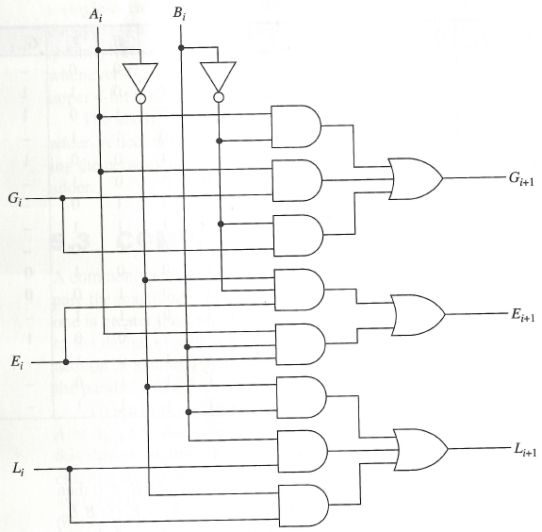
Comparators

Slide 31
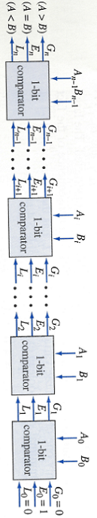
Comparators

Slide 32
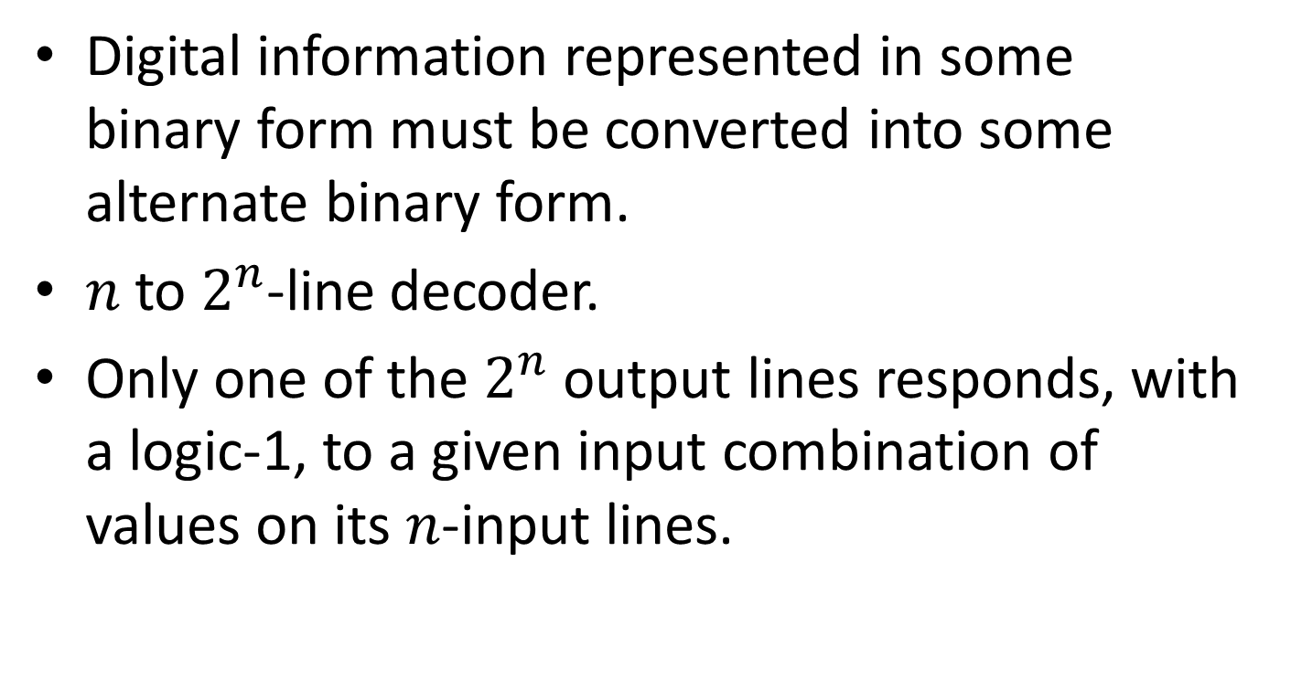
Decoder
Digital information represented in some binary form must be converted into some alternate binary form.
$n$ to $2^{n}$-line decoder.
Only one of the $2^{n}$ output lines responds, with a logic-1, to a given input combination of values on its $n$-input lines.

Slide 33
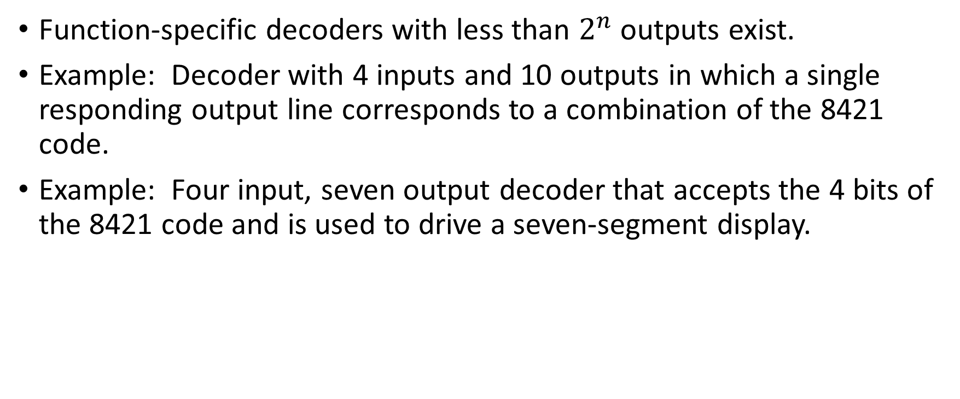
Other types of Decoders
Function-specific decoders with less than $2^{n}$ outputs exist.
Example: Decoder with 4 inputs and 10 outputs in which a single responding output line corresponds to a combination of the 8421 code.
Example: Four input, seven output decoder that accepts the 4 bits of the 8421 code and is used to drive a seven-segment display.

Slide 34
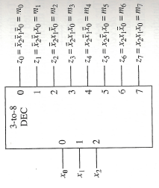
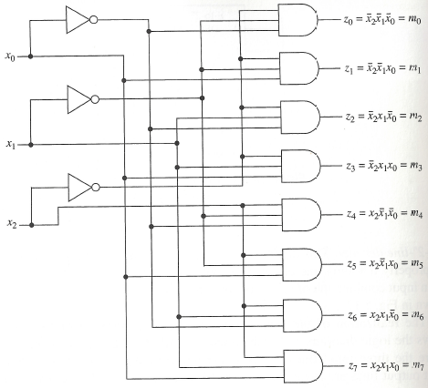
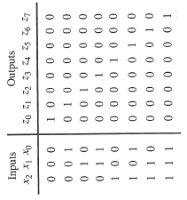
Realization
Symbol
Logic Diagram
Truth Table

Slide 35
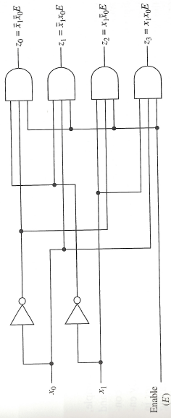
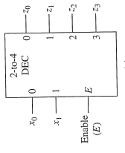
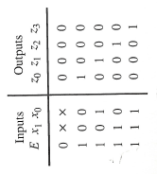
Decoders with an Enable Input
Symbol
Logic Diagram
Truth Table

Slide 36
Decoder
Input combinations can be regarded as binary numbers with the consequences that the j-th output line is at logic-1 for j = 0, 1, . . , 7 only when input combination j is applied.

Slide 37
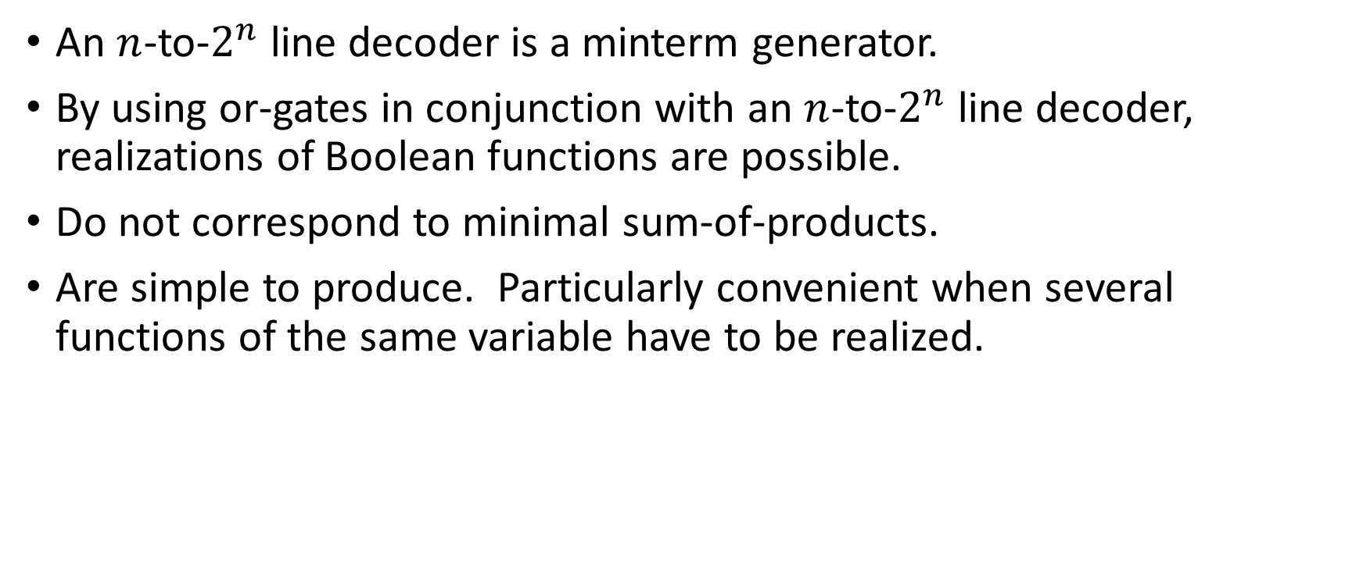
Logic Design Using Decoders
An $n$-to-$2^{n}$ line decoder is a minterm generator.
By using or-gates in conjunction with an $n$-to-$2^{n}$ line decoder, realizations of Boolean functions are possible.
Do not correspond to minimal sum-of-products.
Are simple to produce. Particularly convenient when several functions of the same variable have to be realized.

Slide 38
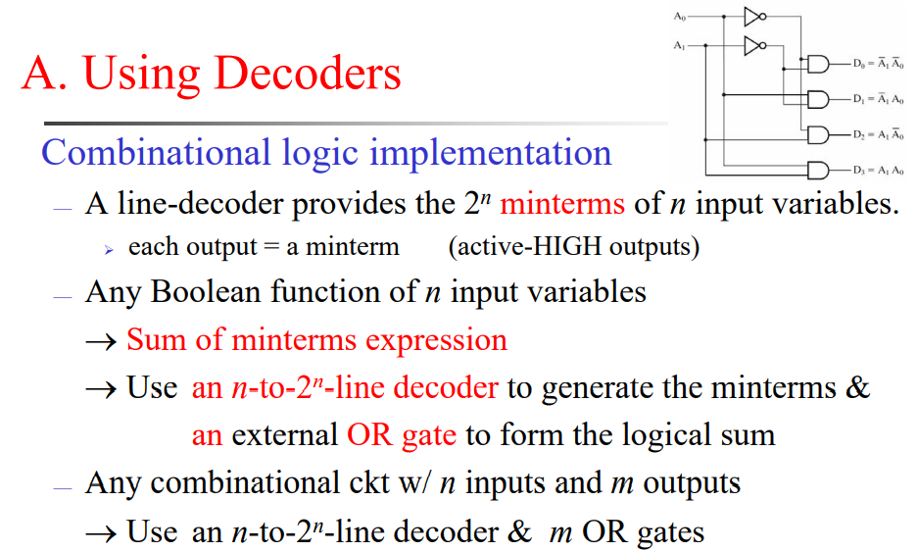

Slide 39
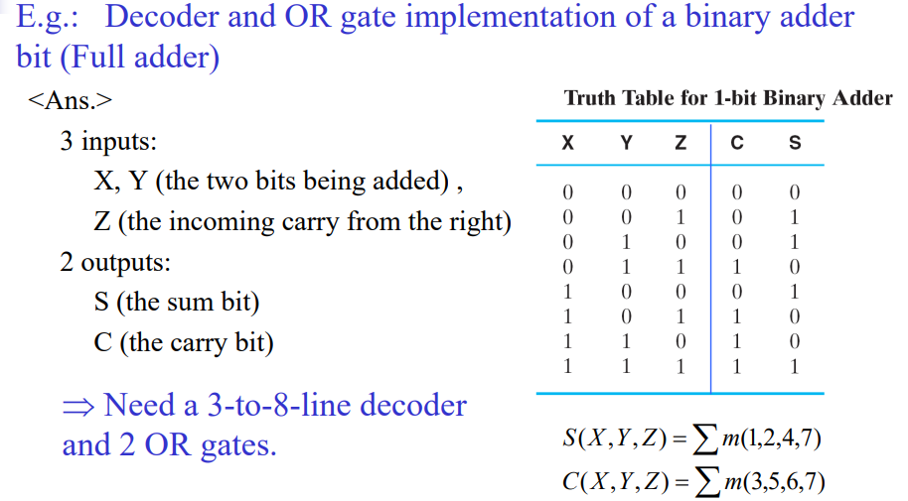

Slide 40
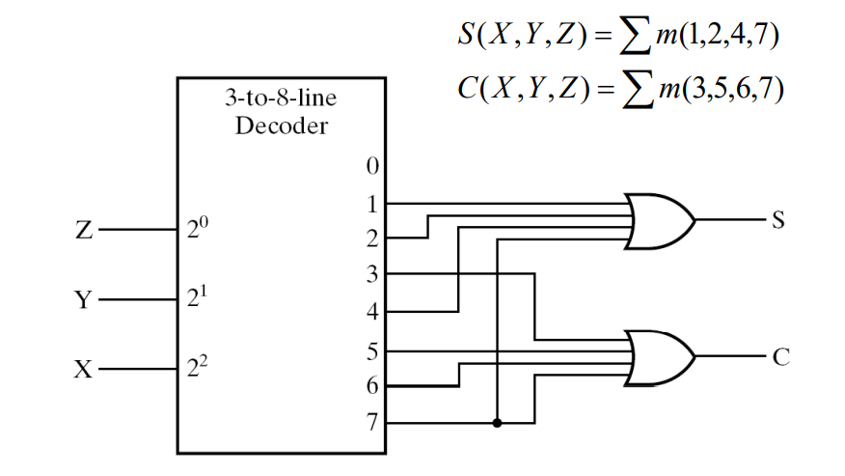

Slide 41
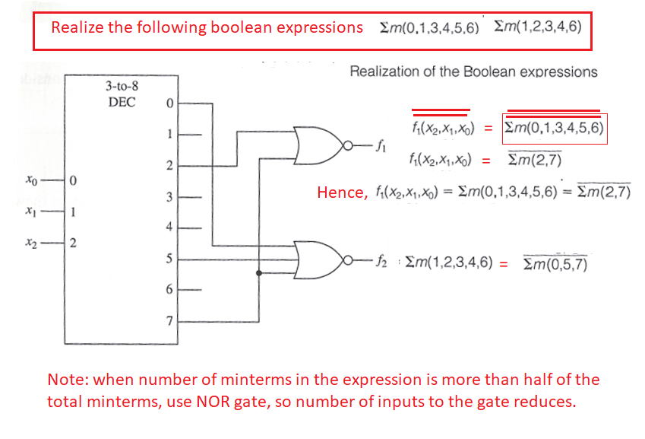

Slide 42
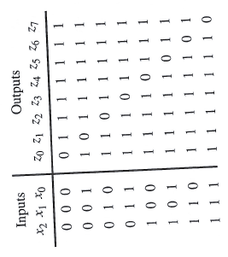
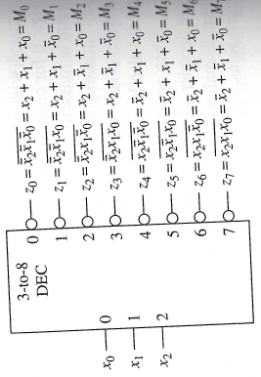
Decoders with Active Low Outputs: (Implementing a Decoder using AND/NAND)
Symbol
Symbol
Truth Table

Slide 43
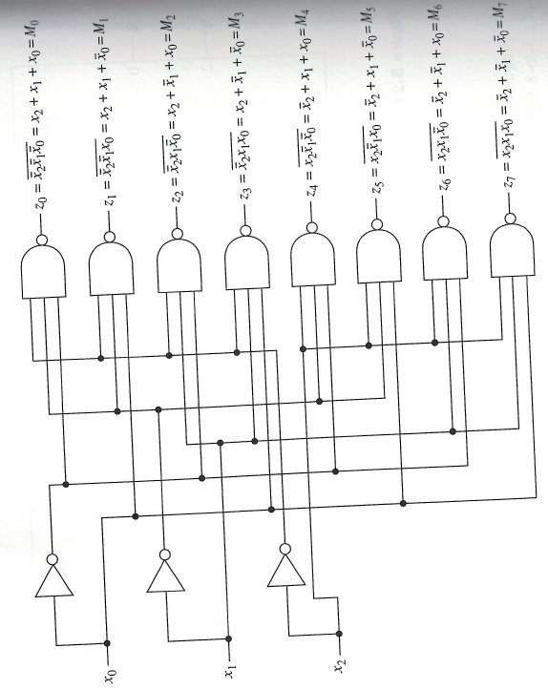
Logic Diagram

Slide 44
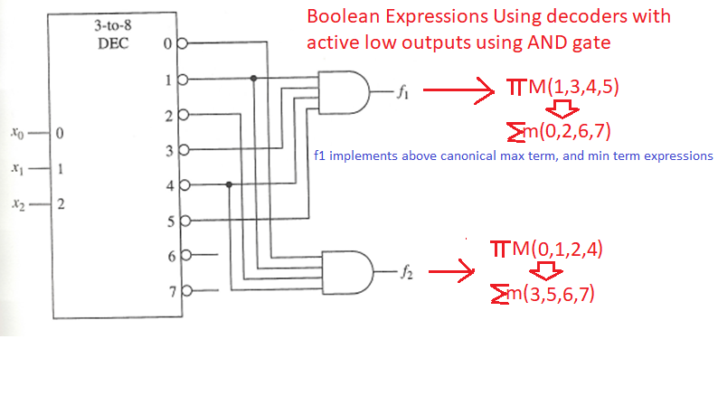

Slide 45
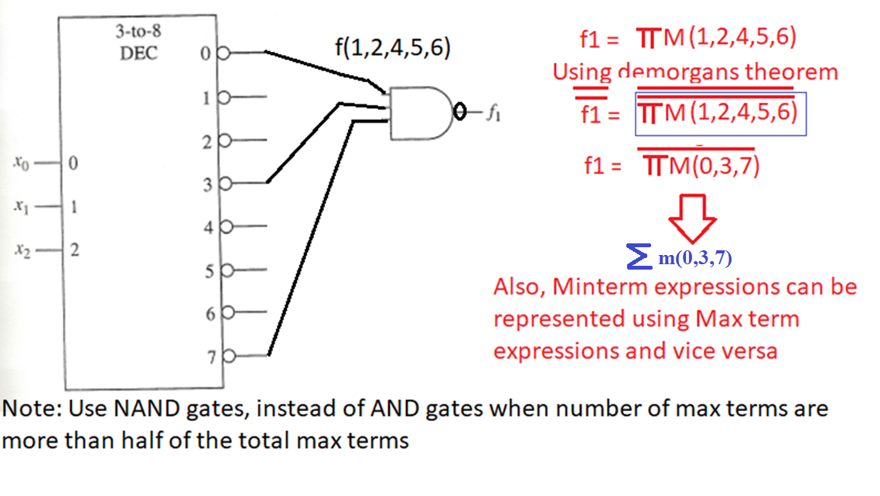

Slide 46
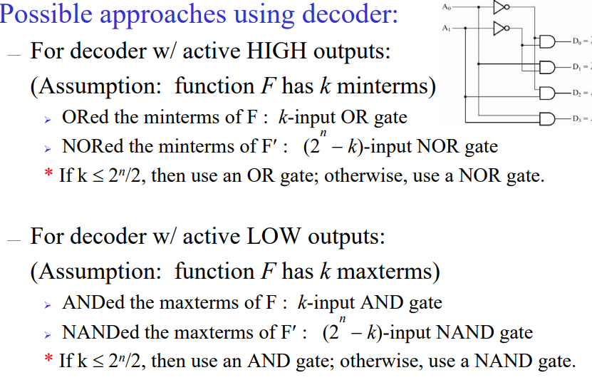
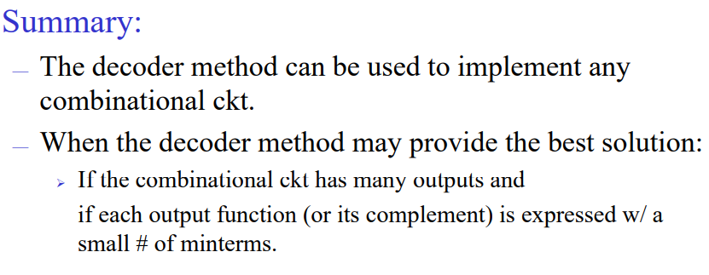

Slide 47
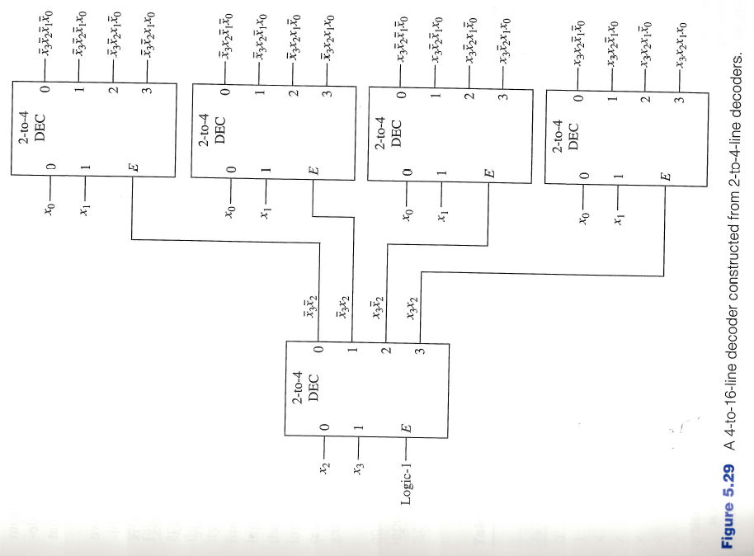
Constructing Larger Decoders

Slide 48
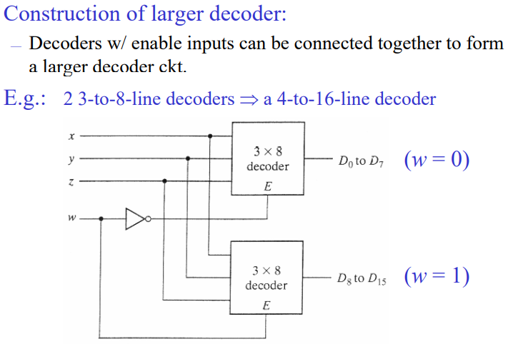

Slide 49
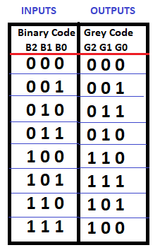
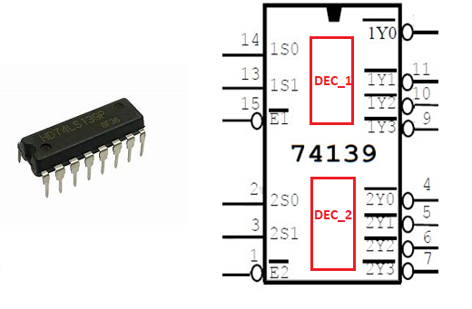
Realization of Binary to Gray Code Converter and vice-versa using IC 74139
Preparation of Greycode
0 0 0
0 0 1
------
0 1 1
0 1 0
-----------
1 1 0
1 1 1
1 0 1
1 0 0

Slide 50
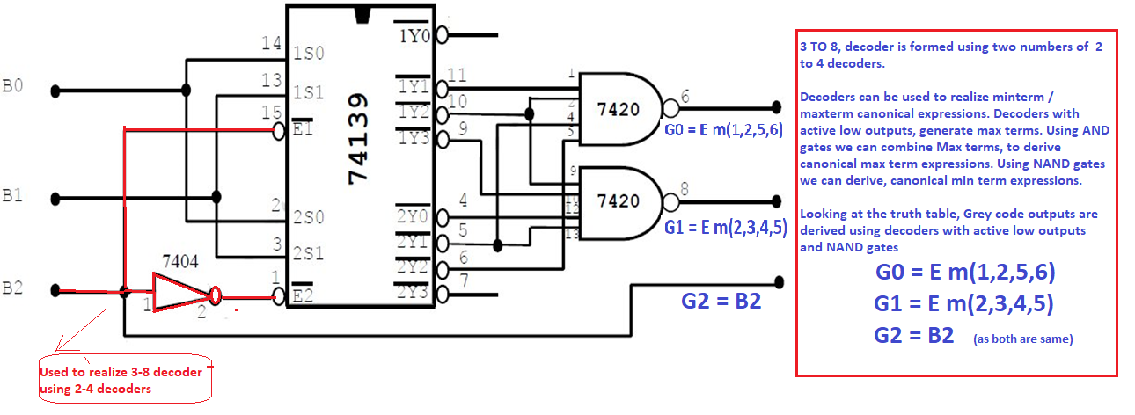

Slide 51
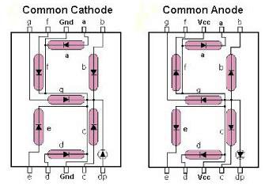

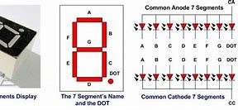

Realization of Decoder using IC-7447

Slide 52

74LS47 is a BCD to 7-segment decoder/driver IC. It accepts a binary coded decimal as input and converts it into a pattern to drive a seven-segment for displaying digits 0 to 9.
Binary coded decimal (BCD) is an encoding in which each digit of a number is represented by its own binary sequence (usually of four bits).
For example 239 in BCD is represented as 0010 0011 1001.
74LS47 IC accepts four lines of BCD (8421) input data and generates their complements internally. The data is decoded with seven AND/OR gates to drive indicator LEDs of the seven segment directly. The outputs correspond to Common anode (CA) configuration of seven segment.

Slide 53


Slide 54


Decoders with enable inputs
When disabled, all outputs of the decoder can either be at logic-0 or logic-1.
Enable input provides the decoder with additional flexibility. Idea: data is applied to the enable input.
Process is known as demultiplexing.
Enable inputs are useful when constructing larger decoders from smaller decoders.
$${\overline{x}}_{0}{\overline{x}}_{1}E$$
If $x_{0}=0, x_{1}=0$ then data appears on line $z_{0}$.
Data

Slide 55


Slide 56

Encoders
Encoders provide for the conversion of binary information from one form to another.
Encoders are essentially the inverse of decoders.
$2^{n}$-to-$n$-line encoder in which an assertive logic value on one of its $2^{n}$-input lines causes the corresponding binary code to appear at the output lines.

Slide 57



Encoders
Equations for 8-to-3-line encoder:
$$z_{0}=x_{1}+x_{3}+x_{5}+x_{7}$$
$$z_{1}=x_{2}+x_{3}+x_{6}+x_{7}$$
$$z_{2}=x_{4}+x_{5}+x_{6}+x_{7}$$
In general, the Boolean expression for the output $z_{i}$ is the sum of each input $x_{j}$ in which the binary representation of $j$ has a 1 in the $2^{i}$-bit position.

Slide 58

Priority Encoder
The assumption that at most a single input to the encoder is asserted at any time is significant in its operation.
Example: Both $x_{3} (11)$ and $x_{5} (101)$ are asserted. What is the output?
$111 \left(x_{7}\right)$
Priority Encoder:
A priority scheme is assigned to the input lines so that whenever more than one input line is asserted at any time, the output is determined by the input line having the highest priority.

Slide 59


Priority Encoder
The output is determined by the asserted input having the highest index.
$x_{i}$ has higher priority than $x_{j}$ if $i>j.$
“Valid” indicates that at least one input line is asserted.
This distinguishes the situation that no input line is asserted from when the $x_{0}$ input line is asserted, since in both cases $z_{2}z_{1}z_{0}=000.$

Slide 60



To realize an Encoder using IC 74147
A priority is assigned to each input so that when two or more inputs are simultaneously active, the input with the highest priority is represented on the output, with input line 9, having the highest priority.
The device provide the to 4-line priority encoding function by use of the implied decimal "zero". The "zero" is encoded when all nine data inputs are HIGH, forcing all four outputs HIGH.

Slide 61


Slide 62

Multiplexer
Also called data selectors.
Basic function: select one of its $2^{n}$ data input lines and place the corresponding information onto a single output line.
$n$ input bits needed to specify which input line is to be selected.
Place binary code for a desired data input line onto its $n$ select input lines.

Slide 63




Realization of 4-to-1 line multiplexer
Symbol
Logic Diagram
Truth Table

Slide 64


Realization of 4-to-1 line multiplexer
Alternate description:
Algebraic description of multiplexer:
$$f= \left(I_{0}{\overline{S}}_{1}{\overline{S}}_{0}+I_{1}{\overline{S}}_{1}S_{0}+I_{2}S_{1}{\overline{S}}_{0}+I_{3}S_{1}S_{2}\right)E$$

Slide 65

Building a Large Multiplexer

Slide 66
Multiplexers
One of the primary applications of multiplexers is to provide for the transmission of information from several sources over a single path.
This process is known as multiplexing.
Demultiplexer = decoder with an enable input.

Slide 67

Multiplexer/Demultiplexer for information transmission

Slide 68


Logic Design with Multiplexers
$$x$$ | $$y$$ | $$z$$ | $$f$$
0 | 0 | 0 | $$f_{0}$$
0 | 0 | 1 | $$f_{1}$$
0 | 1 | 0 | $$f_{2}$$
0 | 1 | 1 | $$f_{3}$$
1 | 0 | 0 | $$f_{4}$$
1 | 0 | 1 | $$f_{5}$$
1 | 1 | 0 | $$f_{6}$$
1 | 1 | 1 | $$f_{7}$$
The Boolean expression corresponding to this truth table can be written as:
$$f\left(x,y,z\right)=f_{0}⋅\overline{x} \overline{y} \overline{z}+f_{1}⋅\overline{x} \overline{y} z+f_{2}⋅\overline{x}y\overline{z}+f_{3}⋅\overline{x}yz+f_{4}⋅x\overline{y} \overline{z}+f_{5}⋅x\overline{y}z+f_{6}xy\overline{z}+f_{7}⋅xyz.$$

Slide 69

Logic Design with Multiplexers
The Boolean expression corresponding to this truth table can be written as:
$f\left(x,y,z\right)=f_{0}⋅\overline{x} \overline{y} \overline{z}+f_{1}⋅\overline{x} \overline{y} z+f_{2}⋅\overline{x}y\overline{z}+f_{3}⋅\overline{x}yz+f_{4}⋅x\overline{y} \overline{z}+f_{5}⋅x\overline{y}z+f_{6}xy\overline{z}+f_{7}⋅xyz.$
The Boolean expression for an 8-to-1-line multiplexer is:
$$f=\left(I_{0}{\overline{S}}_{2}{\overline{S}}_{1}{\overline{S}}_{0}+I_{1}{\overline{S}}_{2}{\overline{S}}_{1}S_{0}+I_{2}{\overline{S}}_{2}S_{1}{\overline{S}}_{0}+I_{3}{\overline{S}}_{2}S_{1}S_{0}+I_{4}S_{2}{\overline{S}}_{1}{\overline{S}}_{0}+I_{5}S_{2}{\overline{S}}_{1}S_{0}+I_{6}S_{2}S_{1}{\overline{S}}_{0}+I_{7}S_{2}S_{1}S_{0}\right).$$

Slide 70


























Logic Design with Multiplexers
If E is logic-1 then the latter is transformed into the former by replacing $I_{i}$ with $f_{i}$, $S_{2}$ with $x$, $S_{1}$ with $y$, and $S_{0}$ with z.
Placing $x,y,z$ on the select lines $S_{2},S_{1},S_{0}$, respectively and placing the functional values $f_{i}$ on data input lines $I_{i}$.
$$f_{0}$$
8-to-1
MUX
$$I_{0}$$
$$f_{1}$$
$$I_{1}$$
$$f_{2}$$
$$I_{2}$$
$$f_{3}$$
$$I_{3}$$
$$f$$
$$f_{4}$$
$$I_{4}$$
$$f_{5}$$
$$I_{5}$$
$$f_{6}$$
$$I_{6}$$
$$f_{7}$$
$$I_{7}$$
$$1$$
$$E$$
$$S_{2}$$
$$S_{1}$$
$$S_{0}$$
$$x$$
$$y$$
$$z$$

Slide 71























Example:
$$x$$ | $$y$$ | $$z$$ | $$f$$
0 | 0 | 0 | $$1$$
0 | 0 | 1 | $$0$$
0 | 1 | 0 | $$1$$
0 | 1 | 1 | $$1$$
1 | 0 | 0 | $$0$$
1 | 0 | 1 | $$1$$
1 | 1 | 0 | $$0$$
1 | 1 | 1 | $$0$$
8-to-1
MUX
$$1$$
$$I_{0}$$
$$0$$
$$I_{1}$$
$$1$$
$$I_{2}$$
$$1$$
$$I_{3}$$
$$0$$
$$f$$
$$I_{4}$$
$$1$$
$$I_{5}$$
$$0$$
$$I_{6}$$
$$0$$
$$I_{7}$$
$$1$$
$$E$$
$$S_{2}$$
$$S_{1}$$
$$S_{0}$$
$$x$$
$$y$$
$$z$$

Slide 72

Logic Design with Multiplexers
If at least one input variable of a Boolean function is available in both its complemented and uncomplemented form, any $n$-variable function is realizable with a $2^{n−1}$-to-1-line multiplexer.
For the case of a 3-variable function, only a 4-to-1 multiplexer is needed.
$f\left(x,y,z\right)=f_{0}⋅\overline{x} \overline{y} \overline{z}+f_{1}⋅\overline{x} \overline{y} z+f_{2}⋅\overline{x}y\overline{z}+f_{3}⋅\overline{x}yz+f_{4}⋅x\overline{y} \overline{z}+f_{5}⋅x\overline{y}z+f_{6}xy\overline{z}+f_{7}⋅xyz$
$$=\left(f_{0}⋅\overline{z}+f_{1}⋅z\right)\overline{x} \overline{y}+\left(f_{2}⋅\overline{z}+f_{3}⋅z\right)\overline{x}y+\left(f_{4}⋅\overline{z}+f_{5}⋅z\right)x\overline{y}+\left(f_{6}⋅\overline{z}+f_{7}⋅z\right)xy$$
When E = 1, 4-to-1 Multiplexer has the form
$$I_{0}{\overline{S}}_{1}{\overline{S}}_{0}+I_{1}{\overline{S}}_{1}S_{0}+I_{2}S_{1}{\overline{S}}_{0}+I_{3}S_{1}S_{2}$$

Slide 73

Logic Design with Multiplexers
$$f(x,y,z)=\left(f_{0}⋅\overline{z}+f_{1}⋅z\right)\overline{x} \overline{y}+\left(f_{2}⋅\overline{z}+f_{3}⋅z\right)\overline{x}y+\left(f_{4}⋅\overline{z}+f_{5}⋅z\right)x\overline{y}+\left(f_{6}⋅\overline{z}+f_{7}⋅z\right)xy$$
4-to-1 Multiplexer has the form
$$f= I_{0}{\overline{S}}_{1}{\overline{S}}_{0}+I_{1}{\overline{S}}_{1}S_{0}+I_{2}S_{1}{\overline{S}}_{0}+I_{3}S_{1}S_{2}$$
Realization of $f(x,y,z)$ is obtained by placing the $x$ and $y$ variables on the $S_{1}, S_{0}$select lines, the single variable functions $f_{i}⋅\overline{z}+f_{j}⋅z$ on the data input lines and let E = 1.
Note: $f_{i}⋅\overline{z}+f_{j}⋅z$ reduce to 0,1,$z$ or $\overline{z}$.

Slide 74








Example
$$x$$ | $$y$$ | $$z$$ | $$f$$
0 | 0 | 0 | $$1$$
0 | 0 | 1 | $$0$$
0 | 1 | 0 | $$1$$
0 | 1 | 1 | $$1$$
1 | 0 | 0 | $$0$$
1 | 0 | 1 | $$1$$
1 | 1 | 0 | $$0$$
1 | 1 | 1 | $$0$$
$$f_{0}⋅\overline{z}+f_{1}⋅z$$
$$f_{2}⋅\overline{z}+f_{3}⋅z$$
$$f_{4}⋅\overline{z}+f_{5}⋅z$$
$$f_{6}⋅\overline{z}+f_{7}⋅z$$
$$1$$
$$x$$
$$y$$

Slide 75







Example
$$x$$ | $$y$$ | $$z$$ | $$f$$
0 | 0 | 0 | $$1$$
0 | 0 | 1 | $$0$$
0 | 1 | 0 | $$1$$
0 | 1 | 1 | $$1$$
1 | 0 | 0 | $$0$$
1 | 0 | 1 | $$1$$
1 | 1 | 0 | $$0$$
1 | 1 | 1 | $$0$$
$$\overline{z}$$
$$1$$
$$z$$
$$0$$
$$1$$
$$x$$
$$y$$

Slide 76

Logic Design with Multiplexers and K-maps
Consider 3-variable Karnaugh map. Assume x is placed on the $S_{1}$ line and y is placed on the $S_{0}$ line.
We get that the output is: $I_{0}\overline{x} \overline{y}+I_{1}\overline{x}y+I_{2}x\overline{y}+I_{3}xy$
$I_{0}\overline{x} \overline{y}$ corresponds to those cells in which $x=0,y=0$
$I_{1}\overline{x}y$ corresponds to those cells in which $x=0,y=1$
$I_{2}x\overline{y}$ corresponds to those cells in which $x=1,y=0$
$I_{3}xy$ corresponds to those cells in which $x=1,y=1$

Slide 77























K-map representation
$$S_{0}=y$$
$$yz$$
$$00$$
$$01$$
$$11$$
$$10$$
$$S_{1}=x$$
$$I_{0}$$
$$I_{1}$$
$$I_{2}$$
$$I_{3}$$
$$z$$
$$z$$
$$z$$
$$z$$
$$0$$
$$1$$
$$0$$
$$1$$
$$0$$
$$1$$
$$0$$
$$1$$
$I_{0}$ map
$I_{1}$ map
$I_{2}$ map
$I_{3}$ map

Slide 78


















Example
$$S_{0}=y$$
$$yz$$
$$x$$ | $$y$$ | $$z$$ | $$f$$
0 | 0 | 0 | $$1$$
0 | 0 | 1 | $$0$$
0 | 1 | 0 | $$1$$
0 | 1 | 1 | $$1$$
1 | 0 | 0 | $$0$$
1 | 0 | 1 | $$1$$
1 | 1 | 0 | $$0$$
1 | 1 | 1 | $$0$$
$$00$$
$$01$$
$$11$$
$$10$$
1 | 0 | 1 | 1
0 | 1 | 0 | 0
$$S_{1}=x$$
$$z$$
$$z$$
$$z$$
$$z$$
$$0$$
$$1$$
$$0$$
$$1$$
$$0$$
$$1$$
$$0$$
$$1$$
1 | 0
1 | 1
0 | 1
0 | 0
$I_{0}$ map
$I_{1}$ map
$I_{2}$ map
$I_{3}$ map
$$I_{0}=\overline{z}$$
$$I_{1}=1$$
$$I_{2}=z$$
$$I_{3}=0$$

Slide 79
Realization
$$x$$ | $$y$$ | $$z$$ | $$f$$
0 | 0 | 0 | $$1$$
0 | 0 | 1 | $$0$$
0 | 1 | 0 | $$1$$
0 | 1 | 1 | $$1$$
1 | 0 | 0 | $$0$$
1 | 0 | 1 | $$1$$
1 | 1 | 0 | $$0$$
1 | 1 | 1 | $$0$$
$$\overline{z}$$
$$1$$
$$z$$
$$0$$
$$1$$
$$x$$
$$y$$

Slide 80
















Alternative Structures
$${S_{1}=y, S}_{0}=z$$
$$yz$$
$$00$$
$$01$$
$$11$$
$$10$$
$$x$$
$$I_{0}$$
$$I_{1}$$
$$I_{3}$$
$$I_{2}$$
Note that order of variables on input lines matters!
$$S_{1}=y$$
$$yz$$
$$00$$
$$01$$
$$11$$
$$10$$
$$S_{0}=x$$
$$I_{0}$$
$$I_{2}$$
$$I_{1}$$
$$I_{3}$$

Slide 81

8-to-1-line multiplexers and 4-variable Boolean functions
Can do the same thing, three variables are placed on select lines, inputs to the data lines are single-variable functions.
Example:

Slide 82

Can we do better?
By allowing realizations of $m$-variable functions as inputs to the data input lines, $2^{n}$-to-1-line multiplexers can be used in the realization of $(n+m)$-variable functions.
E.g.: input variables w and x are applied to the $S_{1}, S_{0}$ select inputs. Functions of the y and z variables appear at the data input lines.

Slide 83

K-map Structure

Slide 84





Example:
$$f\left(x,y,z\right)=∑m(0,1,5,6,7,9,13,14)$$

Slide 85

Example

Slide 86

Example
Multiplexer Tree

